Slide 1


Why Join
?
Organisation

Slide 2




12
Reasons to join an
WAO

Slide 3

Table of
Content
About Us
Advisory Committee
Our Team
Objective
Future Projects
Join Us
Membership Categories
Scan for Register

Slide 4

About
WAO
We Are One
#federationarmy
Unity, Progress & Excellence
Welcome to WAO - We Are One, a National, non-governmental, non-profit organization dedicated to promoting unity and inclusivity. Our mission is to bring together students and individuals from diverse backgrounds, encouraging collaboration and engagement in activities that extend beyond academic pursuits.
At WAO, we firmly believe that our differences make us stronger. We are committed to breaking down barriers and challenging stereotypes, emphasizing the idea that, despite our unique backgrounds, we are one in our shared pursuit of education and personal growth.

Slide 5

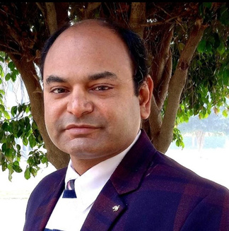

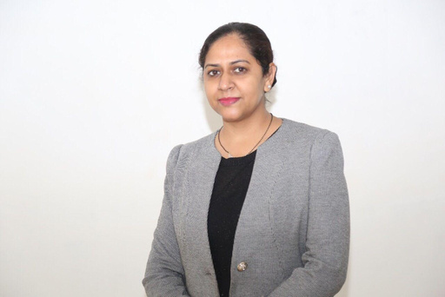
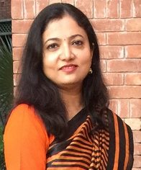



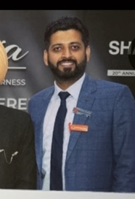


Advisory
committee
Dr. Monica Gulati
Dr. Sachin Kumar
Dr. Navneet Khurana
Dr. Sheetu
Dr. Rashmi Saxena Pal
Sakshi Sharma Dogra
Dr. Pankaj Wadhwa
Sharfuddin mohd.
Dr. Nitin Bhardwaj
Dr. Violina Kakoty
Dr. Ankit

Slide 6
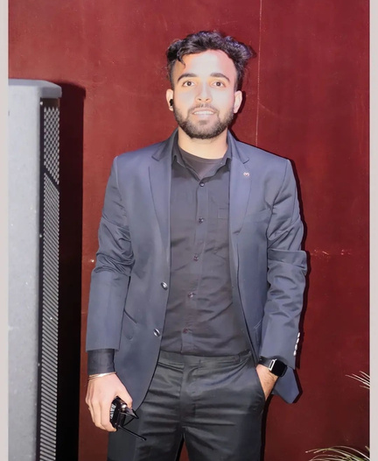
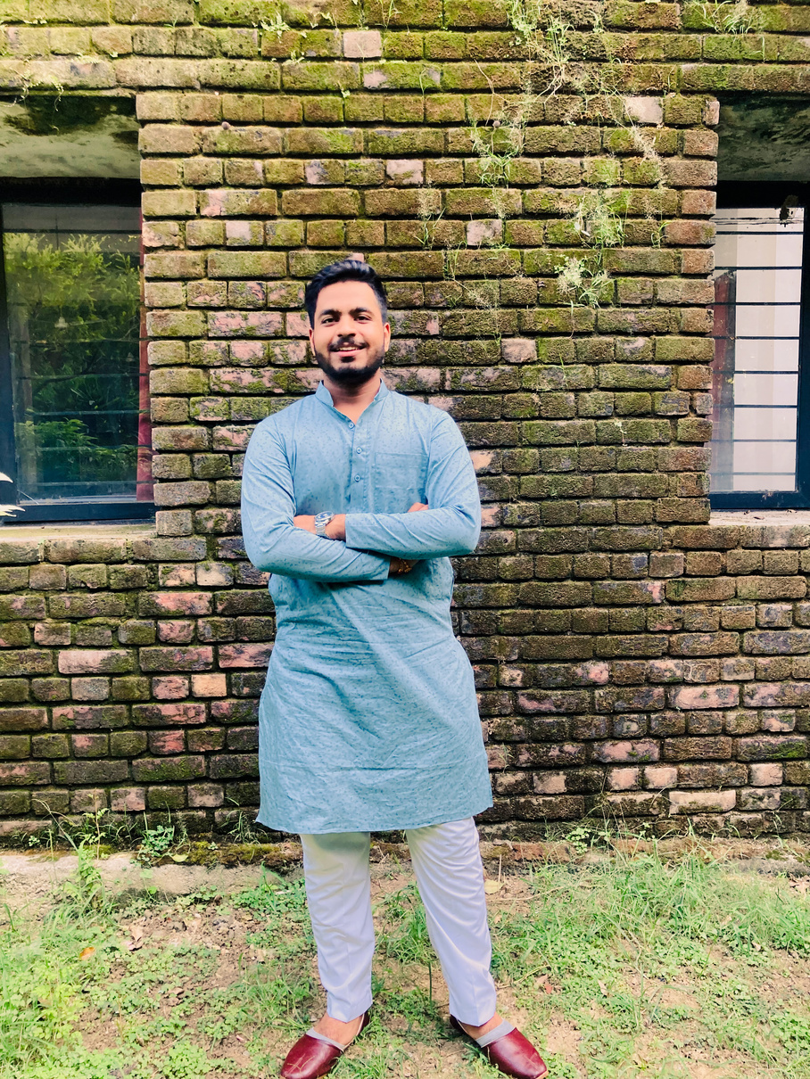


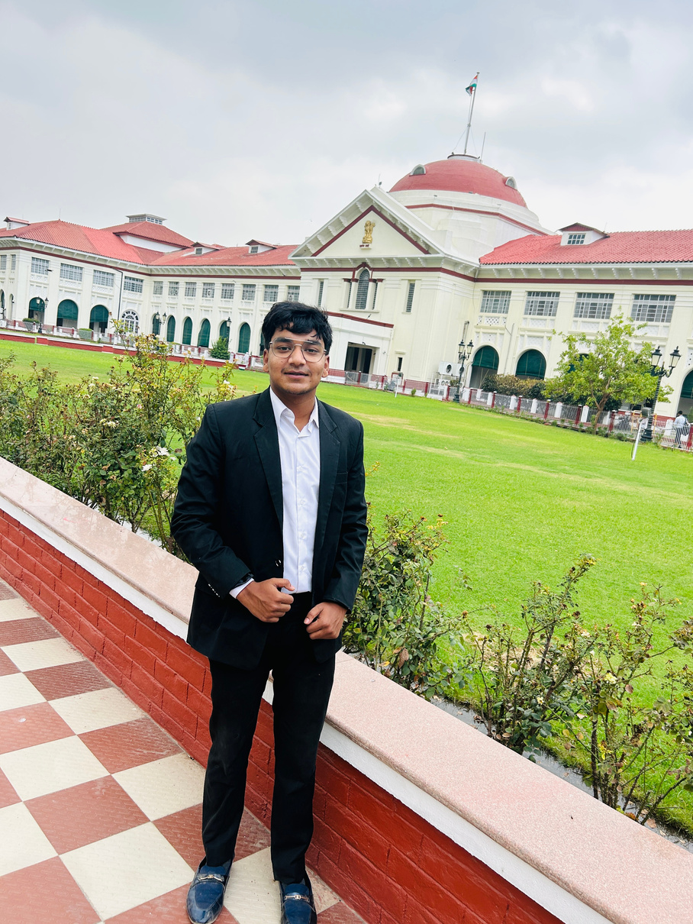


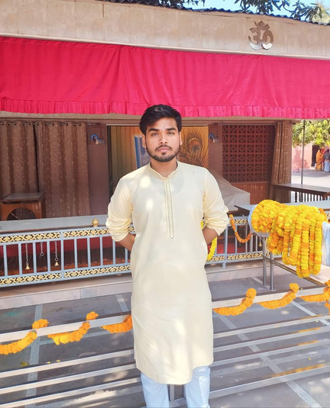
Our Team
Alok Ranjan
Ankush Yadav
Ashish Raj
Priyam
Ranveer
Ankur
Priyanshu
Shivam

Slide 7
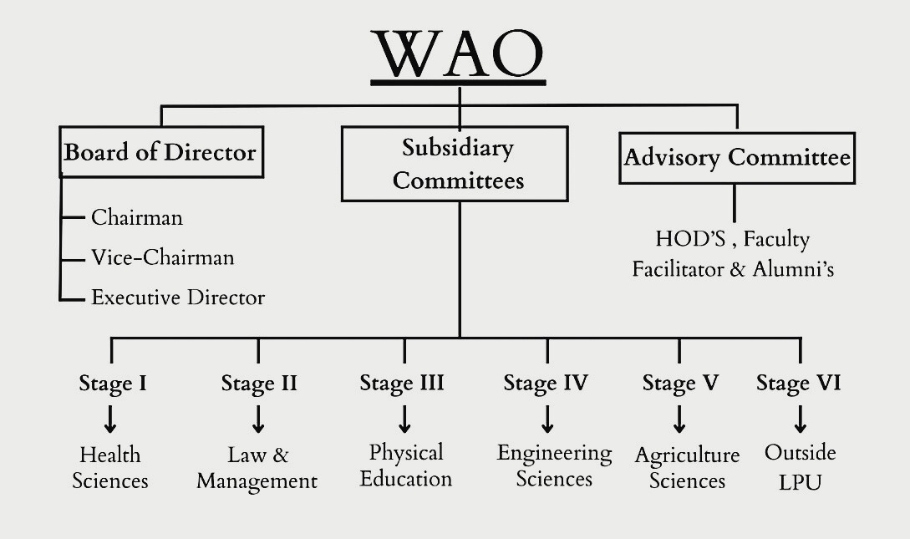
Appendices

Slide 8

Objectives
1. Academic Support
2. Professional Development
3. Social and Cultural Activities
4. Community Service
5. Skill Development
6. Awareness and Education
7. Networking

Slide 9

Future Projects
1. Community Service Initiatives
2. Environmental Initiatives
3. Health and Wellness Programs
4. Arts and Innovation Projects
5. Social Justice and Advocacy
6. Networking and Career Development
7. Collaborative Projects
8. Workshops and Seminars

Slide 10

Membership
1. Regular Members - Scholars
2. Premium Members - Ambassadors
3. Honorary Members - Visionaries

Slide 11

Membership
Benefits
1. Regular Members - Scholars
Access to all organization events and activities.
Opportunity to run for leadership positions.
Exclusive access to study groups and academic resources.
Networking opportunities with fellow scholars and faculty members
Access to workshops and seminars focused on promoting inclusivity and unity among students from diverse backgrounds,
Participation in selected organization events, promoting a sense of community and shared purpose
Regular updates and a newsletter highlighting upcoming events, success stories, and opportunities for involvement.

Slide 12
Membership
Benefits
2. Premium Members - Ambassadors
All benefits of regular members
Ambassador-exclusive workshops and seminars.
Opportunities to represent the organization at external events.
Access to mentorship programs with successful alumni.
Access to exclusive and advanced workshops on topics like leadership, conflict resolution, and intercultural communication
Special discounts for merchandise, events, and partner programs.
Eligibility for Unity Ambassador awards and recognitions for outstanding Contributions
Eligibility for leadership roles within the organization, allowing them to take on responsibilities in planning and organizing events.

Slide 13

Membership
Benefits
3. Honorary Members - Visionaries
All benefits of Regular and Premium Memberships.
Exclusive invitations to VIP events and dinners.
Lifetime membership and affiliation with the organization.
Opportunity to join the organization's leadership team or committees, enhancing their leadership skills.
Can propose and lead their own projects or initiatives that align with the organization's mission, receiving support and resources.
Eligibility for Unity Ambassador awards & Student Engagement Awards and recognitions outstanding contributions.
Recognition as ambassadors of unity and inclusivity within the organization.

Slide 14





Join Us
@wao.federation
@wao_federation
Join Us at different social media platforms to get prior information about the upcoming updates about new plans and events !!!
@wao-federation
@wao.federation

Slide 15
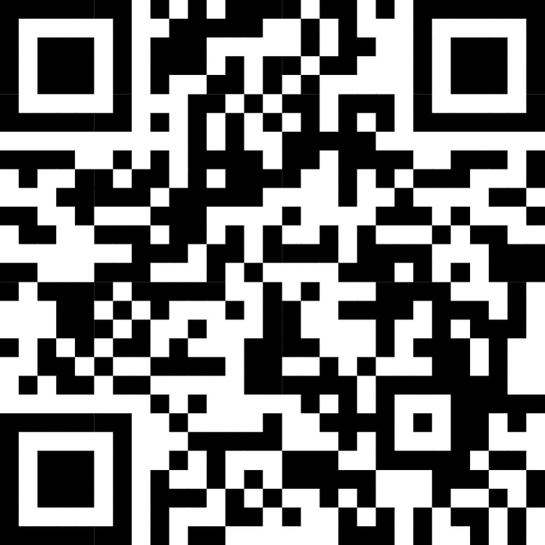
Scan To Register

Slide 16
Thanking You
WAO TEAM

